Slide 1
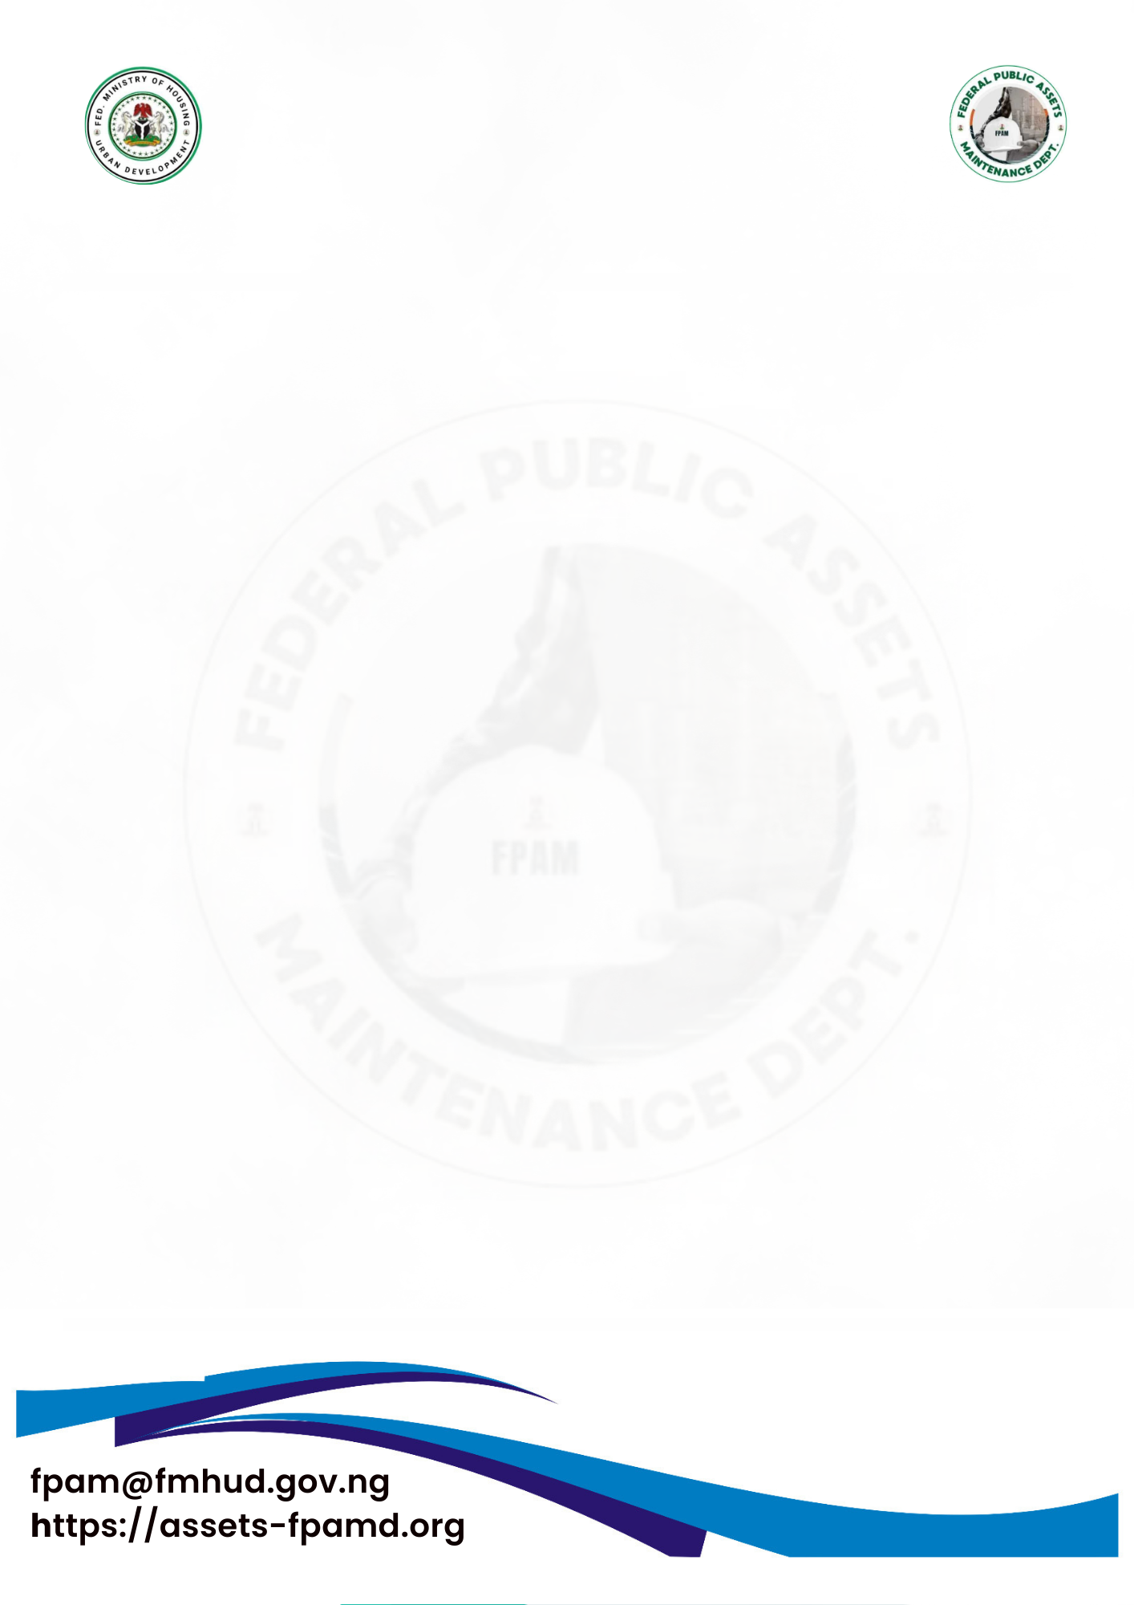
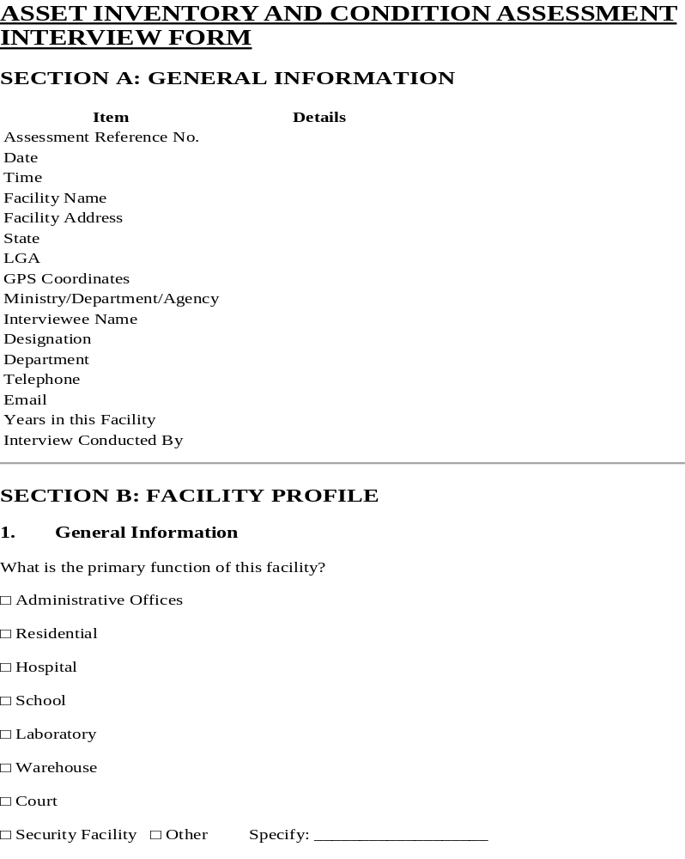

FEDERAL MINISTRY OF HOUSING AND
URBAN DEVELOPMENT
FEDERAL PUBLIC ASSETS MAINTENANCE DEPARTMENT (FPAM)
fpam@fmhud.gov.ng
https://fpam.fmhud.gov.ng

Slide 2
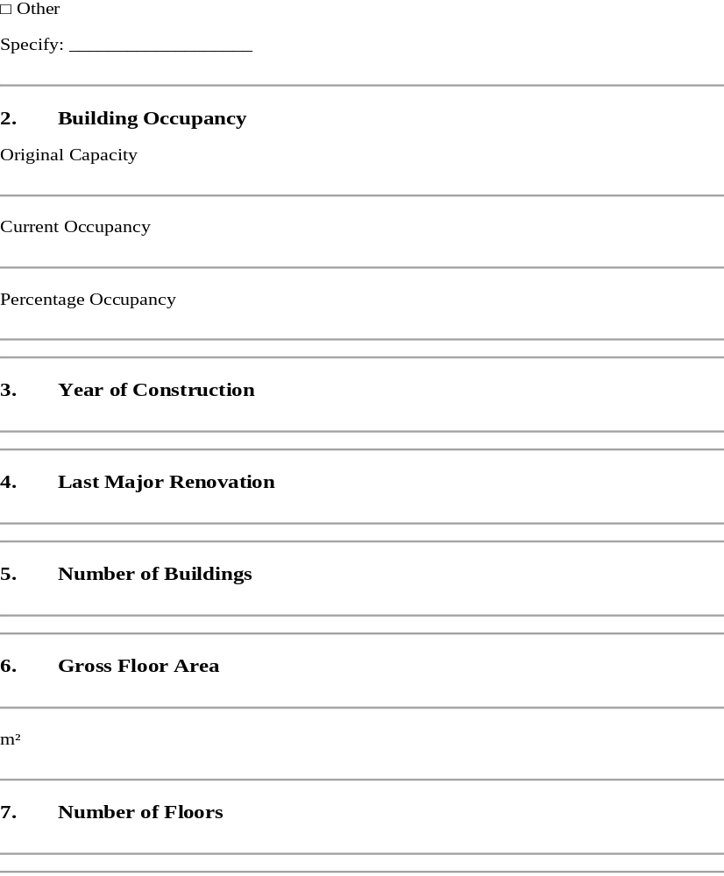
FEDERAL MINISTRY OF HOUSING AND
URBAN DEVELOPMENT
FEDERAL PUBLIC ASSETS MAINTENANCE DEPARTMENT (FPAM)
fpam@fmhud.gov.ng
https://fpam.fmhud.gov.ng

Slide 3
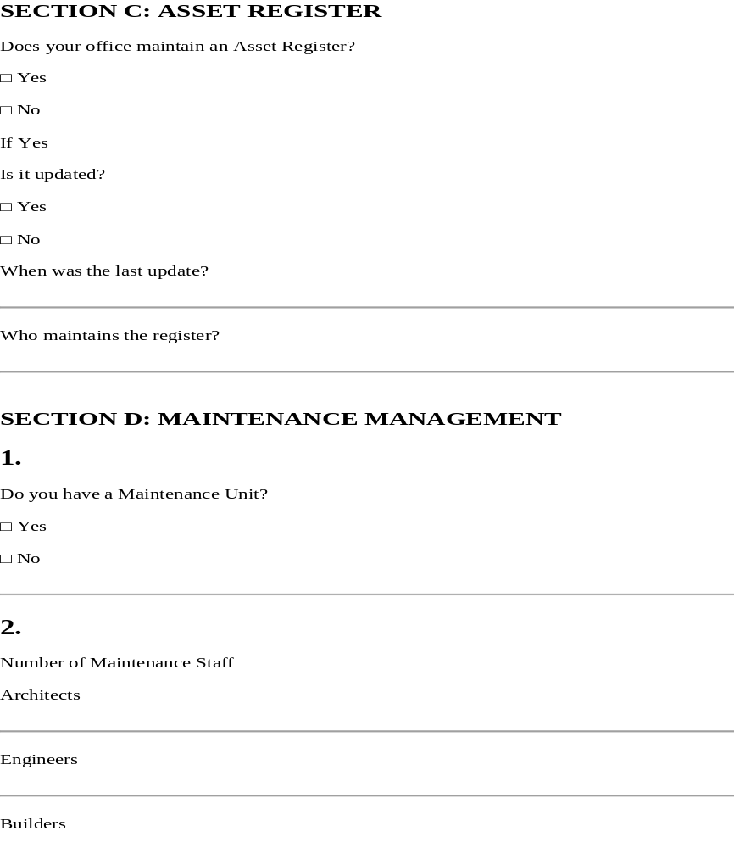
FEDERAL MINISTRY OF HOUSING AND
URBAN DEVELOPMENT
FEDERAL PUBLIC ASSETS MAINTENANCE DEPARTMENT (FPAM)
fpam@fmhud.gov.ng
https://fpam.fmhud.gov.ng

Slide 4
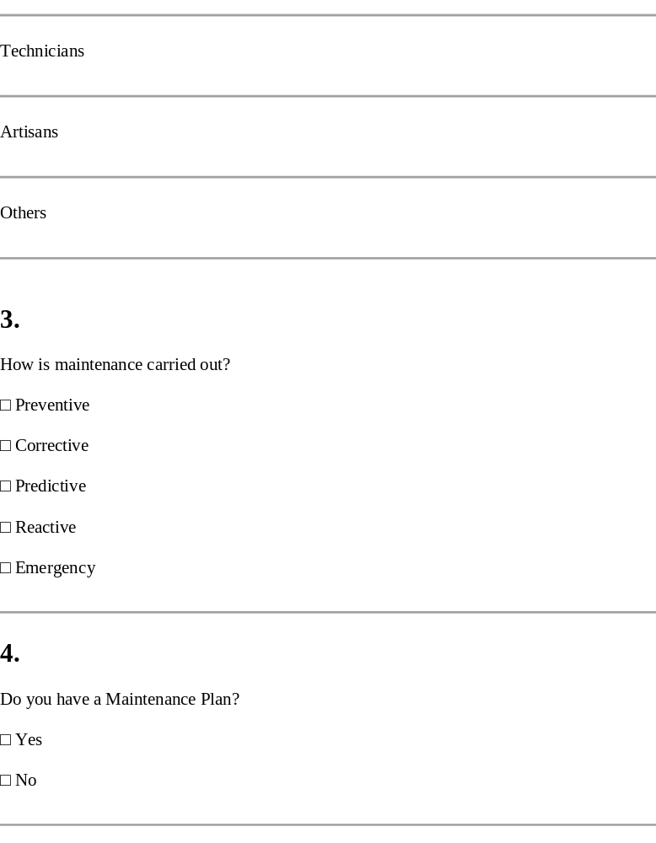
FEDERAL MINISTRY OF HOUSING AND
URBAN DEVELOPMENT
FEDERAL PUBLIC ASSETS MAINTENANCE DEPARTMENT (FPAM)
fpam@fmhud.gov.ng
https://fpam.fmhud.gov.ng

Slide 5
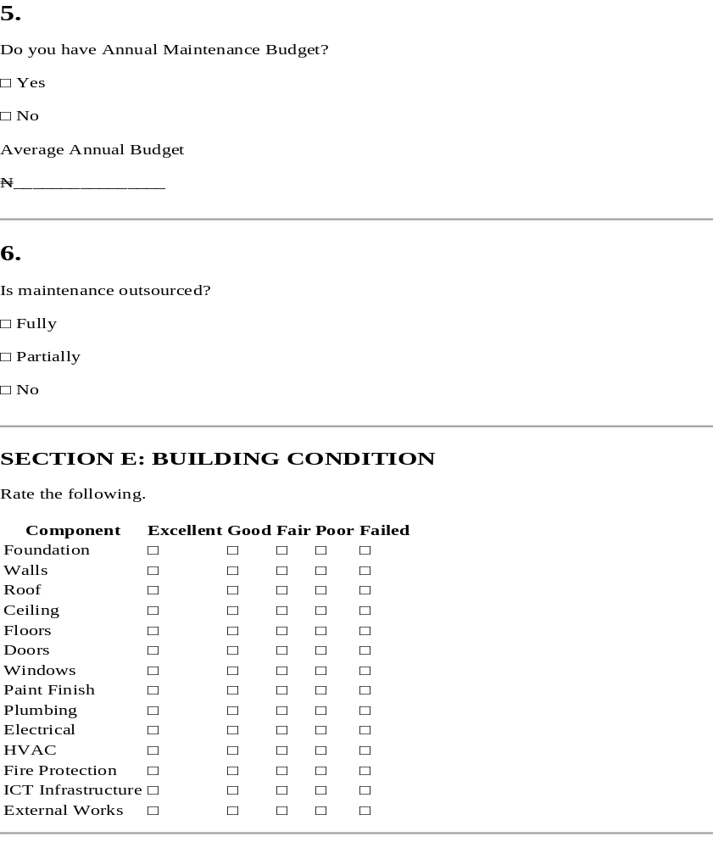
FEDERAL MINISTRY OF HOUSING AND
URBAN DEVELOPMENT
FEDERAL PUBLIC ASSETS MAINTENANCE DEPARTMENT (FPAM)
fpam@fmhud.gov.ng
https://fpam.fmhud.gov.ng

Slide 6
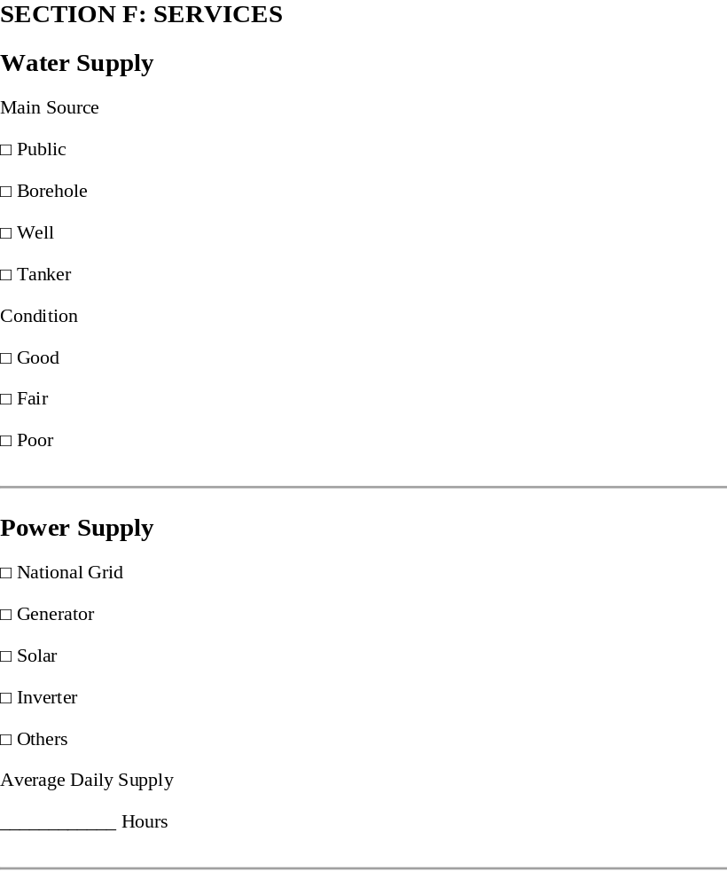
FEDERAL MINISTRY OF HOUSING AND
URBAN DEVELOPMENT
FEDERAL PUBLIC ASSETS MAINTENANCE DEPARTMENT (FPAM)
fpam@fmhud.gov.ng
https://fpam.fmhud.gov.ng

Slide 7
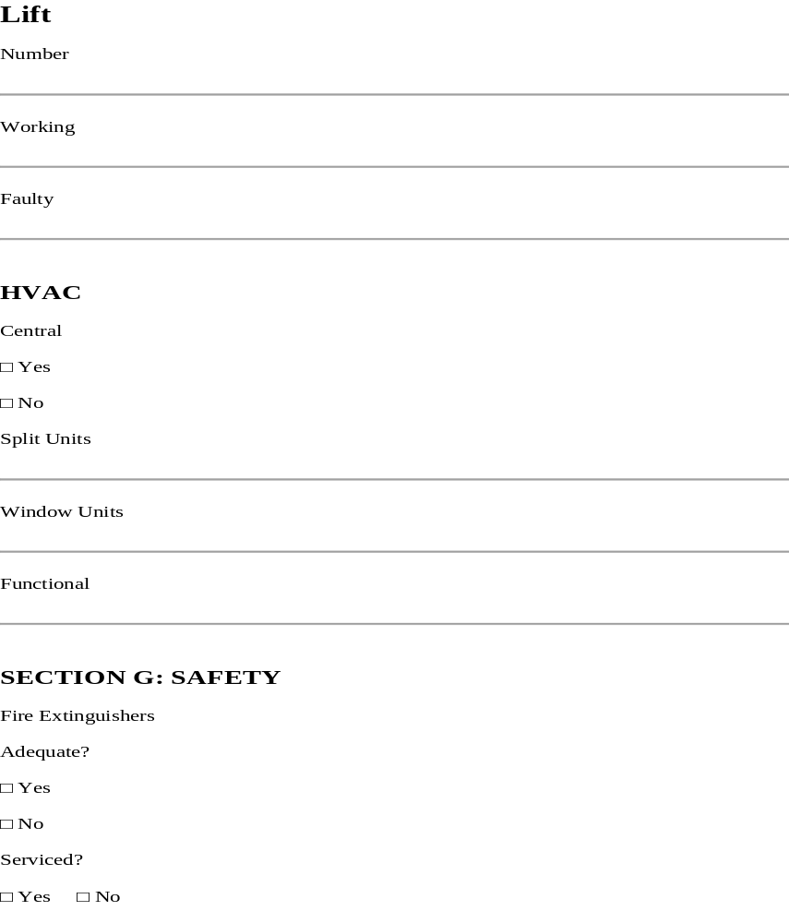
FEDERAL MINISTRY OF HOUSING AND
URBAN DEVELOPMENT
FEDERAL PUBLIC ASSETS MAINTENANCE DEPARTMENT (FPAM)
fpam@fmhud.gov.ng
https://fpam.fmhud.gov.ng

Slide 8
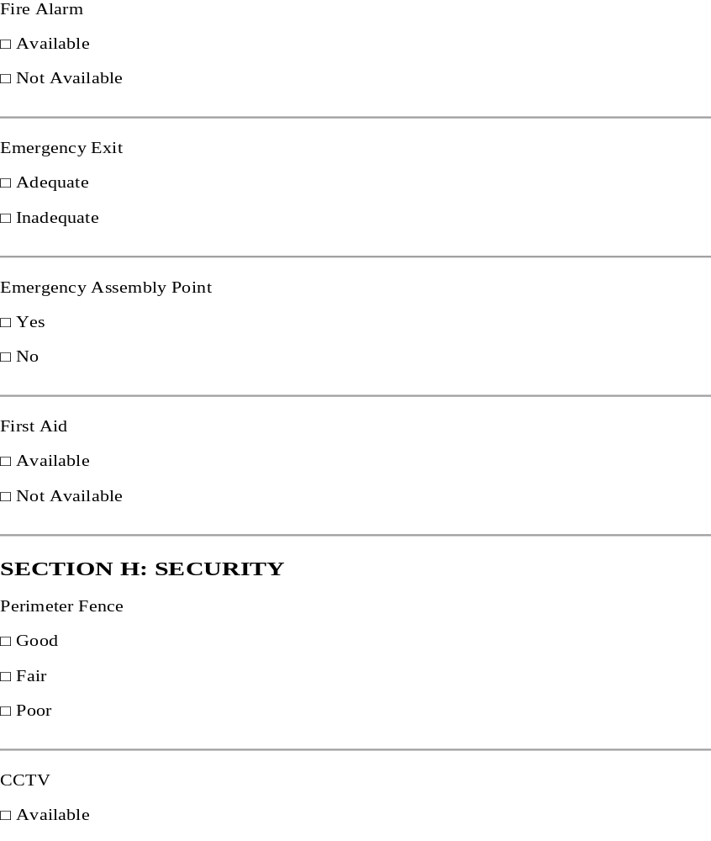
FEDERAL MINISTRY OF HOUSING AND
URBAN DEVELOPMENT
FEDERAL PUBLIC ASSETS MAINTENANCE DEPARTMENT (FPAM)
fpam@fmhud.gov.ng
https://fpam.fmhud.gov.ng

Slide 9
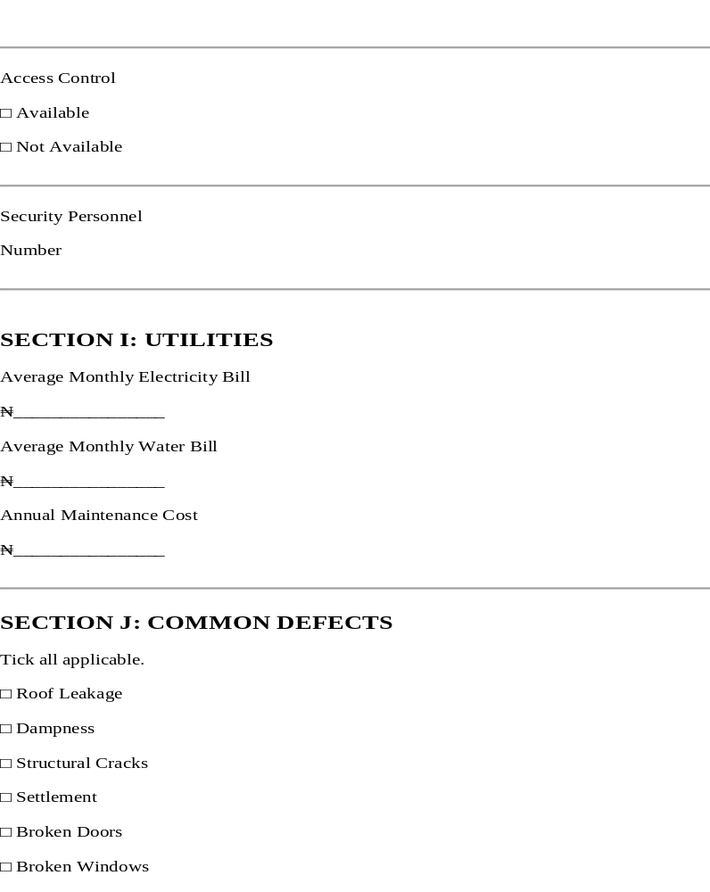
FEDERAL MINISTRY OF HOUSING AND
URBAN DEVELOPMENT
FEDERAL PUBLIC ASSETS MAINTENANCE DEPARTMENT (FPAM)
fpam@fmhud.gov.ng
https://fpam.fmhud.gov.ng

Slide 10
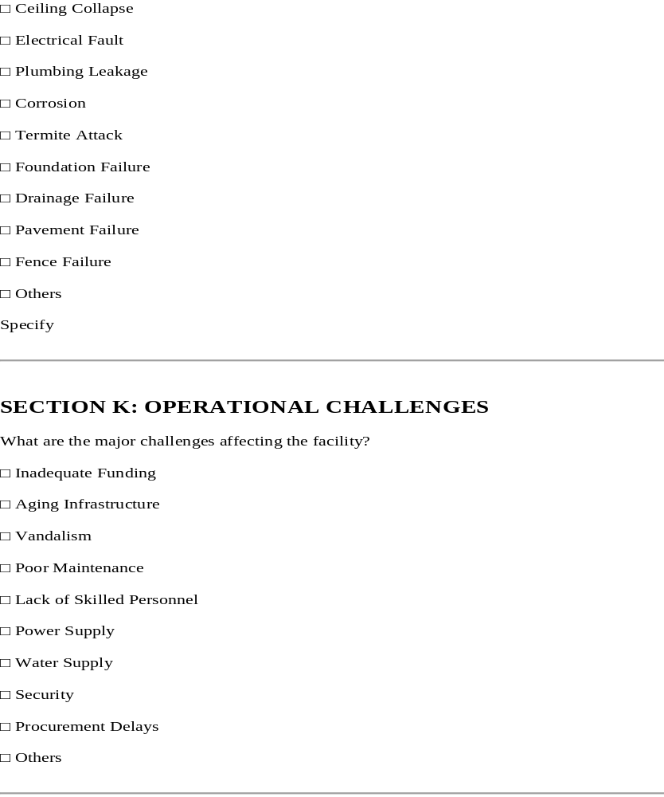
FEDERAL MINISTRY OF HOUSING AND
URBAN DEVELOPMENT
FEDERAL PUBLIC ASSETS MAINTENANCE DEPARTMENT (FPAM)
fpam@fmhud.gov.ng
https://fpam.fmhud.gov.ng

Slide 11
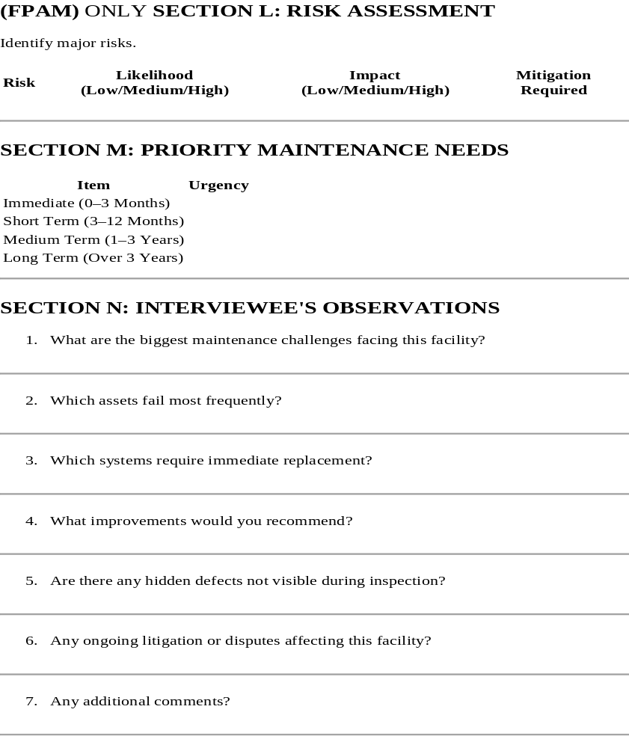
FEDERAL MINISTRY OF HOUSING AND
URBAN DEVELOPMENT
FEDERAL PUBLIC ASSETS MAINTENANCE DEPARTMENT (FPAM)
fpam@fmhud.gov.ng
https://fpam.fmhud.gov.ng

Slide 12
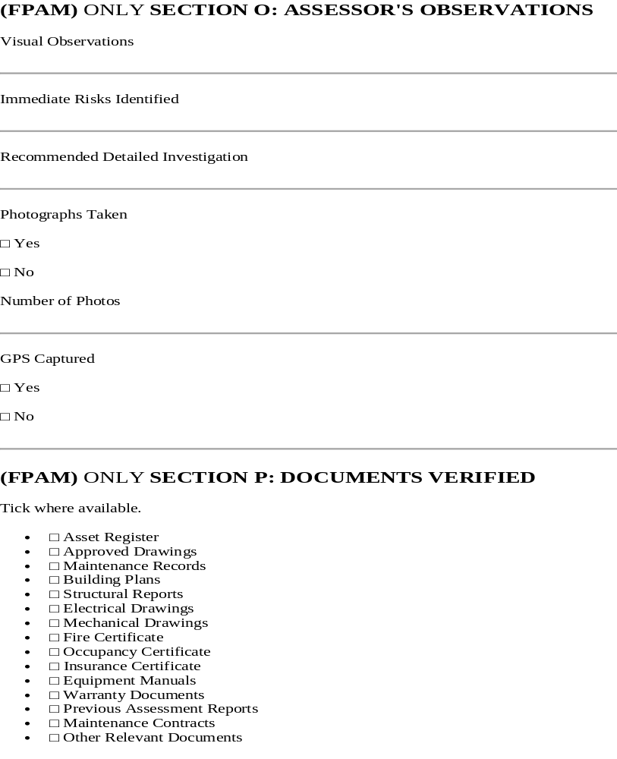
FEDERAL MINISTRY OF HOUSING AND
URBAN DEVELOPMENT
FEDERAL PUBLIC ASSETS MAINTENANCE DEPARTMENT (FPAM)
fpam@fmhud.gov.ng
https://fpam.fmhud.gov.ng

Slide 13
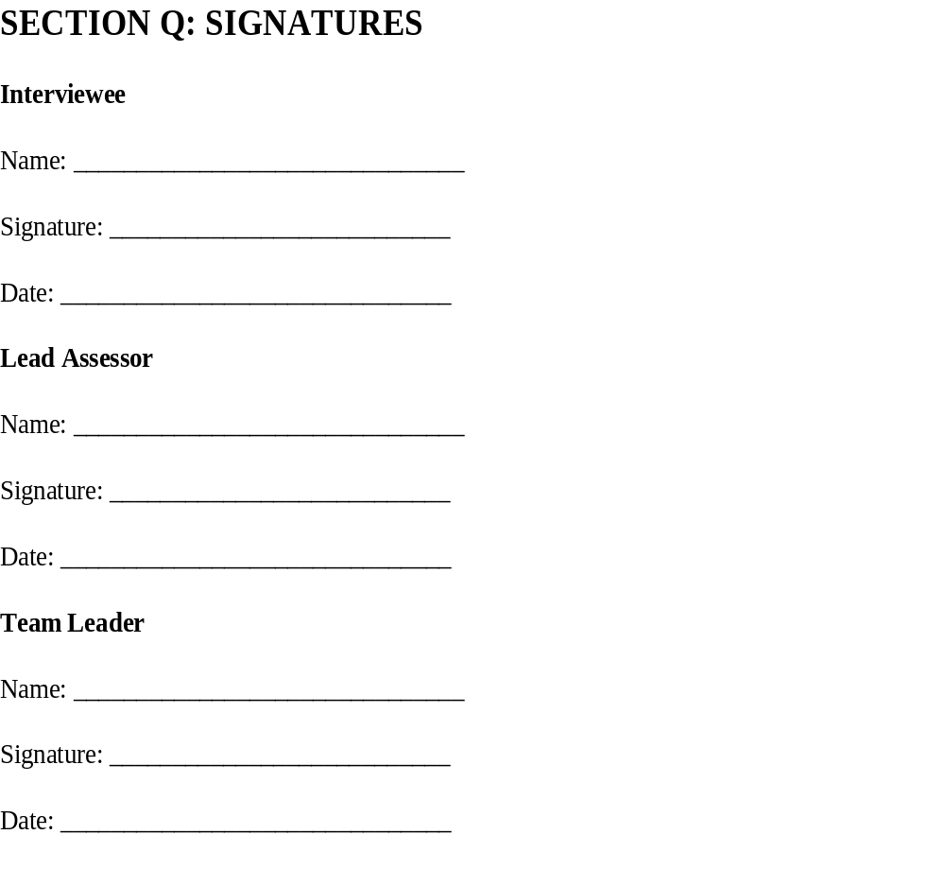
FEDERAL MINISTRY OF HOUSING AND
URBAN DEVELOPMENT
FEDERAL PUBLIC ASSETS MAINTENANCE DEPARTMENT (FPAM)
fpam@fmhud.gov.ng
https://fpam.fmhud.gov.ng

